Slide 1
Classication of Pneumonia from chest X-rays using Transfer Learning
Tushar Shailesh Dalvi
x18134301
MSc. Data Analytics
National College of Ireland

Slide 2
Agenda
Introduction
Research Question
Literature Review
Methodology
Business Understanding
Design
Environment Setup
Data Understanding and Preprocessing
Implementation
Evaluation
Result

Slide 3
Introduction
What is Pneumonia ?
Pneumonia is one of the common diseases throughout human history. In this, the alveoli (air sac) which are inside the lungs are filled with the fluid, which makes it harder for the lungs to pass oxygen into the bloodstream.
In 2016, 51,537 death caused by pneumonia in the USA and in worldwide total 808,694 children suffered death in pneumonia.
Pneumonia can be detected by chest x-ray which is the common and easiest way to detect But required properly trained doctors to detect pneumonia form chest x-ray.
To solve this issue need to develop a new system that can able to detect pneumonia from a chest x-ray.
The main motivation for this study is to develop AI-based system that can detect Pneumonia in an early stage.

Slide 4
Research Question
Can the custom VGG19 model help to improve the recall of pneumonia detection from chest X-ray images as compare state of the art technology?

Slide 5
Literature Review
RSNA Dataset:
Liang and Zheng (2019)
Stephen et al. (2019)
Islam et al. (2019)
Jaiswal et al. (2019)
ChexNet Dataset:
Jaipurkar et al. (2018)
Rahmat et al. (2019)
Abiyev and Ma'aitah (2018)
Heo et al. (2019)
Mendeley Dataset:
Ayan and Unver (2019)
Livieris et al. (2019)
Other Dataset:
Taylor et al. (2018)
Islam et al. (2017)

Slide 6
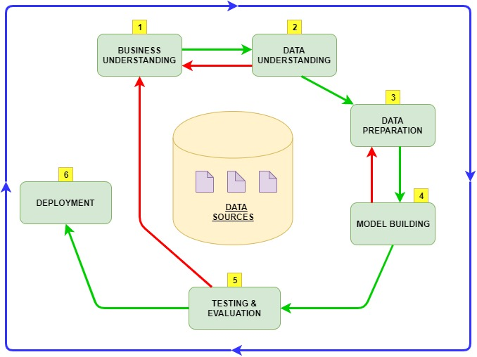
Methodology
its powerful practicality, its flexibility, and its usefulness when using analytics to solve difficult business issues.
In practice, many of the tasks can be performed in a different order and it will often be necessary to backtrack to previous tasks and repeat certain actions.

Slide 7
Business Understanding
The Main Reason to research in this area is to make the detection of pneumonia in an early stage by using AI-Based systems

Slide 8
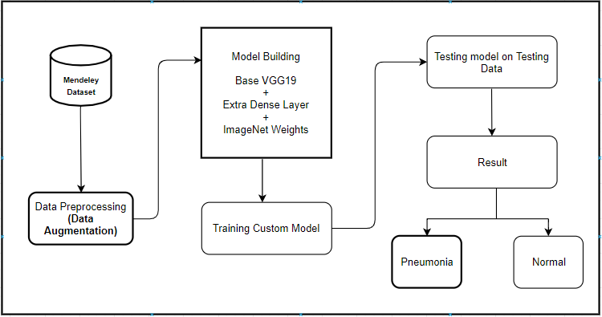
Design

Slide 9
Environment Setup
Software and libraries used:
Python based cloud environment using Google Collaboratory
Data stored on Google Drive
Python Libraries – Pandas, Numpy, Tensorflow, matplotlib, sklearn and seaborn
Evaluation : Accuracy Plot, Loss Plot
Measurement : Recall, Precision, Accuracy, F1 Score

Slide 10
Data Understanding
Dataset Information:
Dataset Downloaded from Mendeley
Total images 5857 including both Pneumonia and Normal
Data Divided into Train, Test and Validation
Every section furthermore divided into Normal and Pneumonia
Training Data having Class imbalance

Slide 11
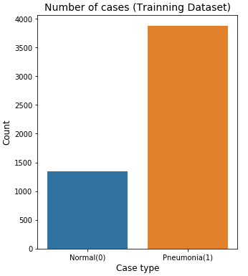
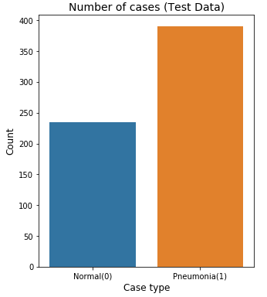
Data Understanding
Training Dataset
Testing Dataset

Slide 12
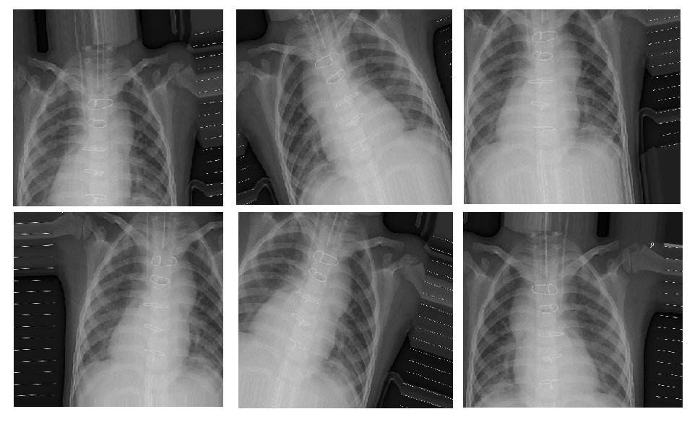
Data Pre-processing
Image Augmentation:
Rescaling
Rotation
Width and Height Shift
Horizontal Flip
Batch Size
Target Size
Shuffle

Slide 13
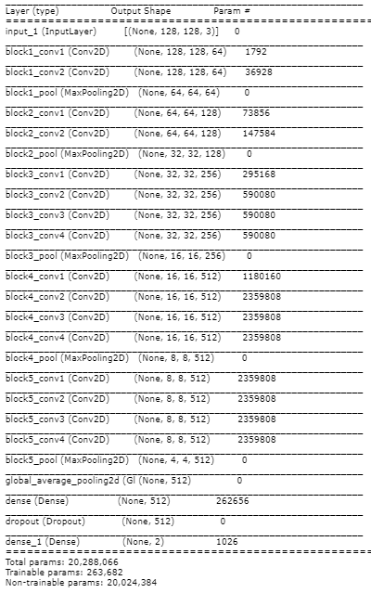
Modeling
Why VGG19 Network
This network characterized by Simplicity.
This model consists of the convolutional layer + pooling layer and followed by fully connected layer.
Convolutional Layer fold the one layer's input and pass as output to the next layer, where each pixel is treated as a relevant variable.
That means it stacks all the features together and produces an output of layer.
The Main task of the Pooling Layer is to reduce dimension, helps to reduce training time.
Fully Connected layer is used to connect every neuron from one layer to another and to classify the image.

Slide 14
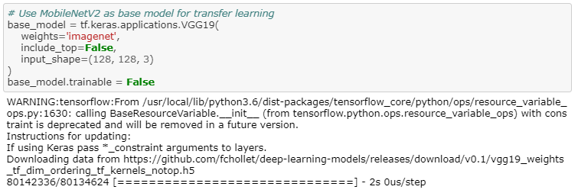
Implementation
Base Model

Slide 15
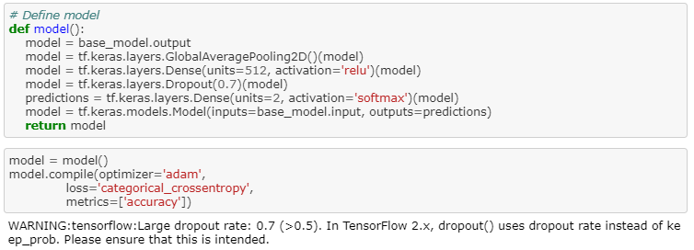
Implementation
Adding Extra layers

Slide 16
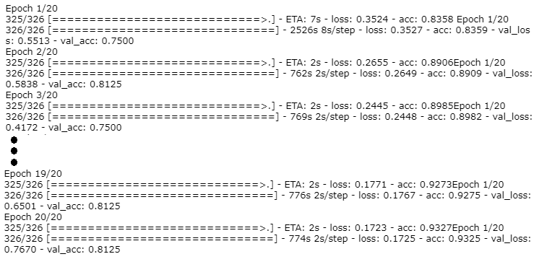
Implementation
Model Training:
Model
No. of epochs 20
All logs are saved to observe model Behaviour
Accuracy plot
Loss plot

Slide 17
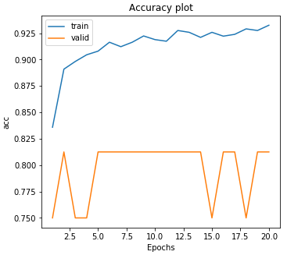
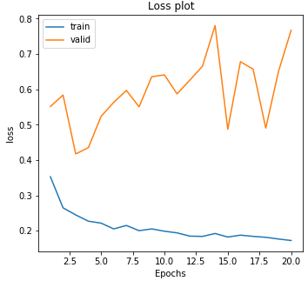
Evaluation
Evaluation Generator: helps to Predict the accuracy of model on testing dataset - 0.86
Accuracy Plot
Loss Plot

Slide 18
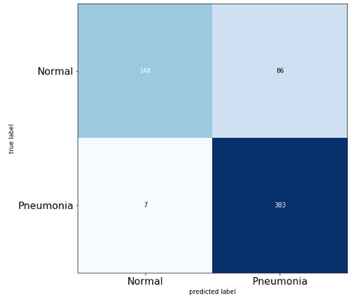
Result
Confusion Matrix
Confusion Matrix is a table that use to describe the performance of classification model.
TP, FP,FN, TN
Recall
Precision
Accuracy
F1 Score

Slide 19
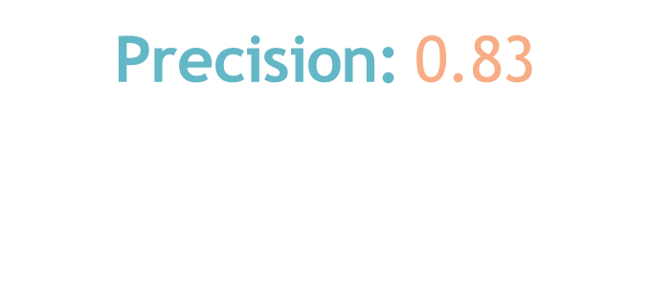
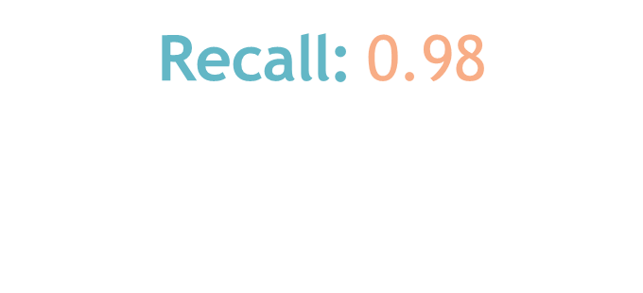
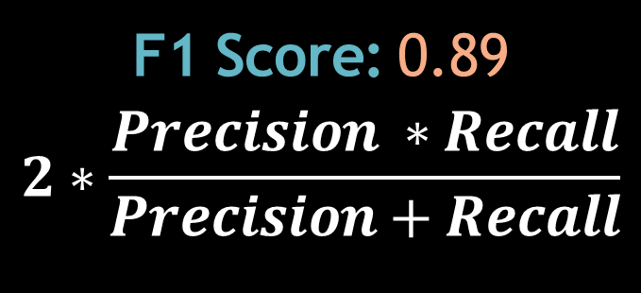
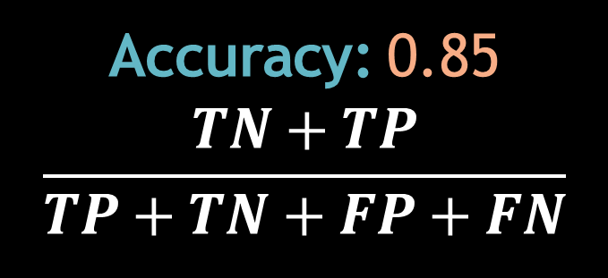
Result
Recall: 0.98
$$\frac{TP}{TP+FN}$$
Precision: 0.83
$$\frac{TP}{TP+FP}$$
Accuracy: 0.85
$$\frac{TN+TP}{TP+TN+FP+FN}$$
F1 Score: 0.89
$$2∗\frac{Precision ∗Recall}{Precision+Recall}$$

Slide 20
I would like to convey my thanks to my supervisor Mr. Noel Cosgrave for his supervision and guidance, his suggestions to read more papers helps a lot to nd new possibilities throughout this study. I would also like to thanks my family and friends for all their support and encouragement, also grateful to Mendeley for sharing a good and rich dataset
Acknowledgement

Slide 21
Thank You

